Slide 1

Department of CSE
Course: AI & ML
Course code: 24AD2001A
Topic:
Ethics, Fairness, Explainability: transparency, human-in-the-loop, Advanced Evaluation Methods: Cross-validation strategies: stratified k-fold, leave-one-out, time series split
Session – 39 &40

Slide 2
Transparency
Transparency is closely related to explainability and is the practice of openly communicating how an AI system was developed and how it works. While explainability focuses on why a model made a specific decision, transparency provides a broader view. Aspects of transparency include:
Algorithmic transparency: Disclosing the logic, reasoning, and data inputs of the AI.
Data transparency: Being open about the data used for training and testing, including its sources and any biases.
Interaction transparency: Informing users when they are interacting with an AI system, such as a chatbot

Slide 3
Human-in-the-loop (HITL)
Human-in-the-loop is an approach that integrates human judgment and oversight into an AI system's lifecycle. Humans can be involved in various stages to provide valuable input and ensure ethical behavior:
Training: Humans can label and annotate data, which is crucial for supervised learning models.
Evaluation: Humans can review and correct a model's predictions, especially in complex or sensitive edge cases that the AI is not equipped to handle.
Oversight: Humans can monitor autonomous systems, with the authority to intervene and override decisions if necessary

Slide 4
Benefits of HITL
Human-in-the-loop machine learning allows humans to provide oversight and input into AI workflows. Here are the primary benefits of human-in-the-loop:
Accuracy and reliability
Ethical decision-making and accountability
Transparency and explainability

Slide 5
Advanced Evaluation Methods: Cross-validation strategies: stratified k-fold
Cross-validation is a technique used to check how well a machine learning model performs on unseen data while preventing overfitting. It works by:
Splitting the dataset into several parts.
Training the model on some parts and testing it on the remaining part.
Repeating this resampling process multiple times by choosing different parts of the dataset.
Averaging the results from each validation step to get the final performance.
Cross-validation addresses a fundamental challenge in machine learning: overfitting. Overfitting occurs when a model performs exceptionally well on training data but poorly on unseen data. This typically happens when the model has memorized the training data rather than learning the underlying patterns.

Slide 6
Benefits of using cross-validation:
Reduces variance: Helps in reducing the variability of model performance by using multiple validation sets.
Better model selection: Assists in choosing the best model or algorithm by providing more reliable error estimates.
Reliable performance estimation: Offers a more truthful understanding of how the model performs in practice.
Hyperparameter tuning: Cross-validation is essential during grid search or random search for selecting optimal parameters.
Data-efficient learning: Makes better use of the dataset, especially when the amount of data is limited.

Slide 7
Common Cross-Validation Techniques
Cross-validation plays a pivotal role in assessing the reliability of machine learning models. To maximize its effectiveness, it's important to select the right validation strategy based on the dataset size, structure, and objective. Below are the most commonly used cross-validation techniques in machine learning:
1. K-Fold Cross-Validation
K-Fold is the most popular form of cross-validation. Here, the dataset is divided into k equal parts or "folds." In each iteration, one fold is used for validation while the remaining k-1 folds are used for training. This process is repeated k times, and the results are averaged for a final performance estimate.
Best For: General-purpose validation with moderate dataset sizes.
Benefits: Balanced bias and variance; efficient for model evaluation.
Limitation: May not preserve class distribution in imbalanced datasets.

Slide 8
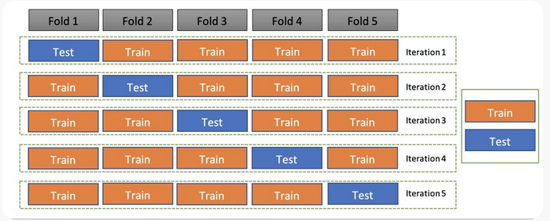
CONTD..
In this technique, the whole dataset is partitioned in k parts of equal size and each partition is called a fold. It’s known as k-fold since there are k parts where k can be any integer - 3,4,5, etc. One fold is used for validation and other K-1 folds are used for training the model. To use every fold as a validation set and other left-outs as a training set, this technique is repeated k times until each fold is used once.

Slide 9
CONTD..
The image above shows 5 folds and hence, 5 iterations. In each iteration, one fold is the test set/validation set and the other k-1 sets (4 sets) are the train set. To get the final accuracy, you need to take the accuracy of the k-models validation data.
This validation technique is not considered suitable for imbalanced datasets as the model will not get trained properly owing to the proper ratio of each class's data.

Slide 10
2. Stratified K-Fold Cross-Validation
2. Stratified K-Fold Cross-Validation
Stratified K-Fold ensures that each fold maintains the same class distribution as the overall dataset. This is particularly useful for classification problems where some classes may be underrepresented.
Best For: Classification with imbalanced class labels.
Benefits: Maintains class ratios across folds; more stable accuracy estimates.
Limitation: Slightly more complex to implement than simple K-Fold.
In the example below, the original dataset contains females that are a lot less than males, so this target variable distribution is imbalanced. In the stratified k-fold cross-validation technique, this ratio of instances of the target variable is maintained in all the folds.

Slide 11
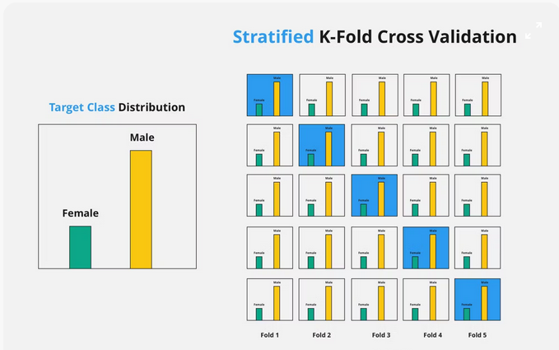
As seen above, k-fold validation can’t be used for imbalanced datasets because data is split into k-folds with a uniform probability distribution. Not so with stratified k-fold, which is an enhanced version of the k-fold cross-validation technique. Although it too splits the dataset into k equal folds, each fold has the same ratio of instances of target variables that are in the complete dataset. This enables it to work perfectly for imbalanced datasets, but not for time-series data.

Slide 12
3. Leave-One-Out Cross-Validation (LOOCV)
3. Leave-One-Out Cross-Validation (LOOCV)
In LOOCV, each data point is used once as the validation set while the rest of the data is used for training. This process repeats n times, where n is the number of data points.
Best For: Very small datasets.
Benefits: Maximum data usage for training; minimal bias.
Limitation: Computationally intensive; can have high variance.
The leave-one-out cross-validation method is computationally expensive to perform and shouldn’t be used with very large datasets. The good news is that the technique is very simple and requires no configuration to specify. It also provides a reliable and unbiased estimate for your model performance.

Slide 13
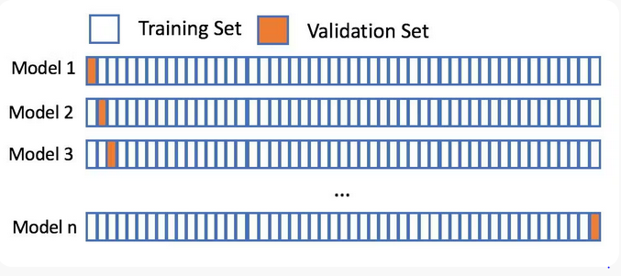
In this technique, only 1 sample point is used as a validation set and the remaining n-1 samples are used in the training set. Think of it as a more specific case of the leave-p-out cross-validation technique with P=1.
To understand this better, consider this example: There are 1000 instances in your dataset. In each iteration, 1 instance will be used for the validation set and the remaining 999 instances will be used as the training set. The process repeats itself until every instance from the dataset is used as a validation sample.

Slide 14
4. Hold-Out Method
4. Hold-Out Method
This is the simplest technique, where the dataset is split once into two parts—typically 70–80% for training and the remainder for validation. It’s quick but can give skewed results if the split isn’t representative.
Best For: Quick performance checks or very large datasets.
Benefits: Fast and easy to implement.
Limitation: High variance; results depend heavily on the random split.

Slide 15
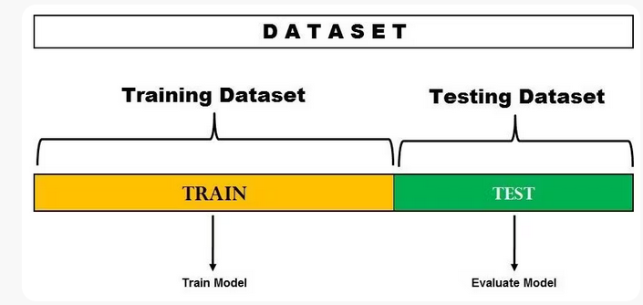
CONTD..
Also called a train-test split, holdout cross-validation has the entire dataset partitioned randomly into a training set and a validation set. A rule of thumb to partition data is that nearly 70% of the whole dataset will be used as a training set and the remaining 30% will be used as a validation set. Since the dataset is split into only two sets, the model is built just one time on the training set and executed faster.

Slide 16
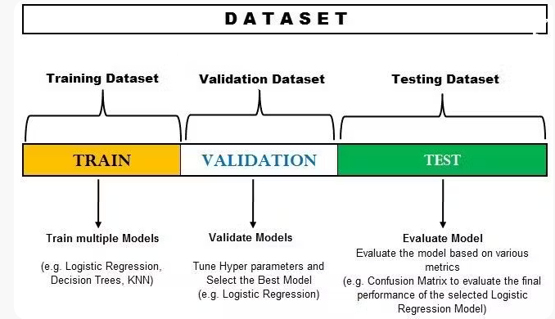
CONTD..
In the image above, the dataset is split into a training set and a test set. You can train the model on the training set and test it on the testing dataset. However, if you want to hyper-tune your parameters or want to select the best model, you can make a validation set like the one below.

Slide 17
5. Repeated Cross-Validation
5. Repeated Cross-Validation
Repeated K-Fold performs K-Fold cross-validation multiple times with different random splits. The final result is averaged across all iterations for a more robust performance estimate.
Best For: When seeking to reduce variance in performance estimates.
Benefits: More reliable and stable results; reduces the impact of random bias.
Limitation: Time-consuming; computationally heavier.

Slide 18
6. Time Series Split (Rolling/Expanding Window)
6. Time Series Split (Rolling/Expanding Window)
In time-series data, maintaining temporal order is crucial. Instead of random splits, data is split sequentially—where the training set consists of all data before a point, and the test set consists of data that follows.
Best For: Forecasting and time-series modeling.
Benefits: Preserves data chronology; realistic scenario testing.
Limitation: Reduced training data in early folds; more sensitive to trends and seasonality.

Slide 19
CONTD..
Time series is the type of data collected at different points in time. This kind of data allows one to understand what factors influence certain variables from period to period. Some examples of time series data are weather records, economic indicators, etc.
In the case of time series datasets, the cross-validation is not that trivial. You can’t choose data instances randomly and assign them the test set or the train set. Hence, this technique is used to perform cross-validation on time series data with time as the important factor.
Since the order of data is very important for time series-related problems, the dataset is split into training and validation sets according to time. Therefore, it’s also called the forward chaining method or rolling cross-validation.

Slide 20
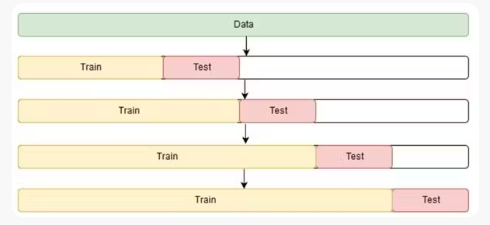
To begin: Start the training with a small subset of data. Perform forecasting for the later data points and check their accuracy. The forecasted data points are then included as part of the next training dataset and the next data points are forecasted. The process goes on.
The image above shows the method.

Slide 21
THANK YOU
Team – AI &ML

